Slide 1

DAYANANDA SAGAR COLLEGE OF ENGINEERING Department of Medical Electronics Engineering
Academic year 2022-2023
MINI PROJECT – IDEA PRESENTATION
USN | NAME
1DS20MD003 | ADITHYA C D
1DS20MD018 | LAXMI
1DS20MD025 | NISARGA V
1DS20MD029 | PRAKRUTHI H U
Under the guidance of
Prof Nanditha Krishna
Medical Electronics
DEPARTMENT OF MEDICAL ELECTRONICS ENGINEERING, DAYANANDA SAGAR COLLEGE OF ENGINEERING

Slide 2
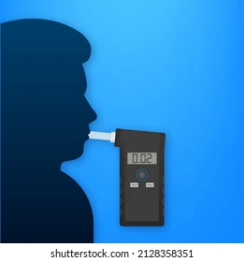
Human Breathalyzer to Monitor Ketosis

Slide 3


Slide 4


Slide 5


Slide 6
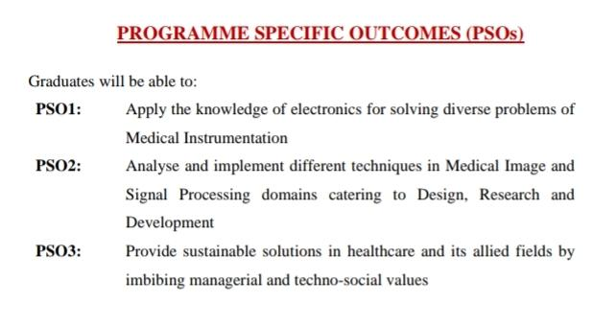

Slide 7
CONTENTS
PROBLEM STATEMENT
MOTIVATION
INTRODUCTION
OBJECTIVES
LITERATURE SURVEY
COMPONENTS
METHODOLOGY
RESULT
CONCLUSION
TIMELINE
REFERENCES

Slide 8
PROBLEM STATEMENT
The problem statement for a human breath analyzer to monitor ketosis would be to develop a device that can accurately and non-invasively measure the levels of ketones in a person's breath, which is an indicator of their state of ketosis.

Slide 9
MOTIVATION
Overall, the motivation behind the acetone breath analyzer project lies in improving the diagnosis, management, and monitoring of medical conditions through a non-invasive, portable, user-friendly, and cost-effective solution.
By addressing the limitations of existing methods, this project has the potential to significantly impact healthcare outcomes and enhance the quality of life for individuals with diabetes, metabolic disorders, and other conditions related to acetone levels in breath.

Slide 10
INTRODUCTION
Acetone is a volatile organic compound that is produced as a byproduct of the metabolism of fats in the liver. When the body is in a state of ketosis, such as during fasting, low-carbohydrate diets, or certain medical conditions like diabetes, the production of acetone increases, and it can be detected in the breath.
Measuring acetone in breath can provide a non-invasive way to monitor the levels of ketones in the body.
acetone has been considered as a main breath biomarker for diabetes. In addition to diabetes, fat burn monitoring is another application for breath acetone.
The ketogenic diet, while originally thought to treat epilepsy in children, is now used for weight loss due to increasing evidence indicating that fat is burned more rapidly when there is a low carbohydrate intake.
The range of acetone concentration in the breath of healthy humans is from 300 to 900 ppb and it is more than 1800 ppb for patients who have diabetes .

Slide 11
OBJECTIVES
The objective of this project is to create a non-invasive and simple way for a person to monitor ketone levels, which acts as a key indicator of an unhealthy glucose level.
Since ketones in the body break down into volatile acetone, the device itself measures the concentration of acetone particles in the user’s breath in order to give a ketone value.
This direct relationship between body ketone levels and the levels of acetone found in breath, is the foundation of the project.

Slide 12
LITERATURE SURVEY
SN | Author | Topic/Publication/Year | Inference
1. | B. Dontha, M. Faltas, P. -I. Gouma and A. Kiourti, | "Electromagnetic-Based Deformation Monitoring for PANI-CA Breath Acetone Sensors," in IEEE Journal of Electromagnetics, RF and Microwaves in Medicine and Biology, vol. 6, no. 4, pp. 524-531, Dec. 2022. | This paper proposes the novel electromagnetic (EM) based mechanism for quantifying bending in PANI-CA chemo-actuators that detect breath acetone and validate feasibility in a proof-of-concept in vitro setup. Breath acetone serves as a biomarker of human metabolism, yet previously reported techniques are invasive, non-continuous, and/or operate at high temperatures.
2 | Y. Obeidat. | "The Most Common Methods for Breath Acetone Concentration Detection: A Review," in IEEE Sensors Journal, vol. 21, no. 13, pp. 14540-14558, 1 July1, 2021. | This paper proposes the review of the most common techniques that are used for breath acetone detection. A comparison between these techniques and the possibility of using them for the diagnosis of diabetes mellitus are presented and discussed in detail. Finally, this review emphasizes the need for cheap, highly sensitive, easy to use and portable devices to help individuals living with diabetes mellitus to monitor their disease.

Slide 13
SN | Author | Topic/Publication/Year | Inference
3 | F. Usman, J. O. Dennis, A. Y. Ahmed, F. Meriaudeau, O. B. Ayodele and A. A. S. Rabih, | "A Review of Biosensors for Non-Invasive Diabetes Monitoring and Screening in Human Exhaled Breath," in IEEE Access, vol. 7, pp. 5963-5974, 2019. | This paper reviews the recent literature on the detection of exhaled breath acetone and acetone vapor of diabetic interest. The biosensors have been classified based on their transduction methods. The performance characteristics of the biosensors have been explored for comparison.
4 | G. Neri, A. Bonavita, G. Micali and N. Donato. | "Design and Development of a Breath Acetone MOS Sensor for Ketogenic Diets Control," in IEEE Sensors Journal, vol. 10, no. 1, pp. 131-136 , Jan. 2010 | This paper proposes the design of a handy and noninvasive measurement of acetone in the human breath, which is useful for ketosis monitoring and control, by means of MOS sensors is reported. The results obtained indicate that MOS sensors based on Pt-In2O 3 nanopowders are promising as fast and quantifiable means of determining acetone in the breath, posing the advantages of real time measurements and low costs devices for the control of ketogenic diet.

Slide 14
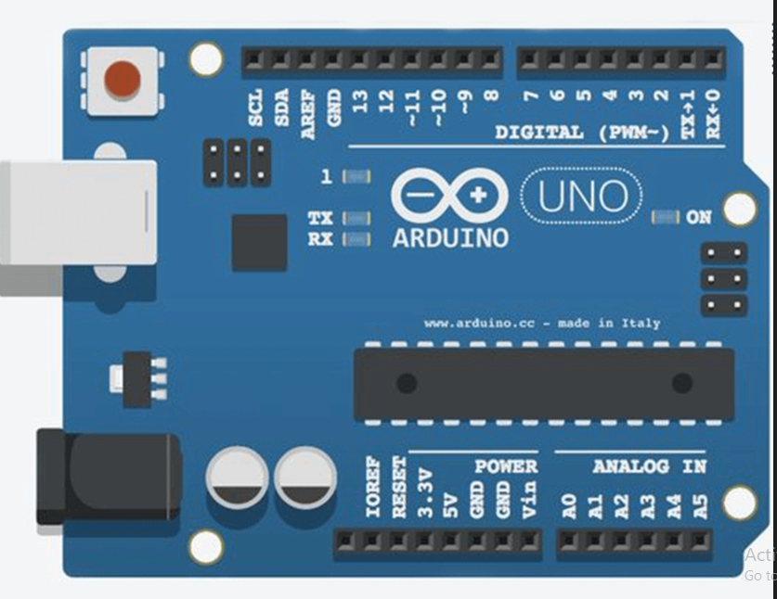
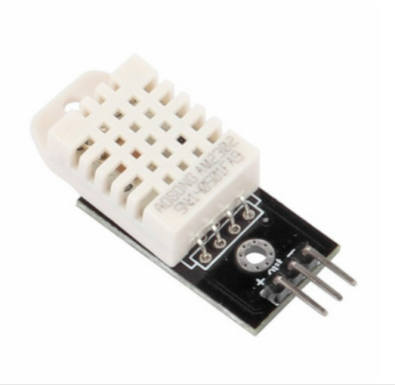
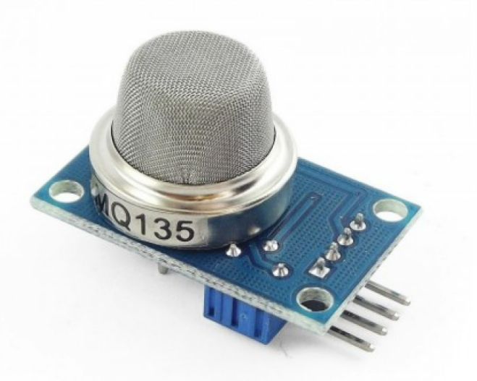
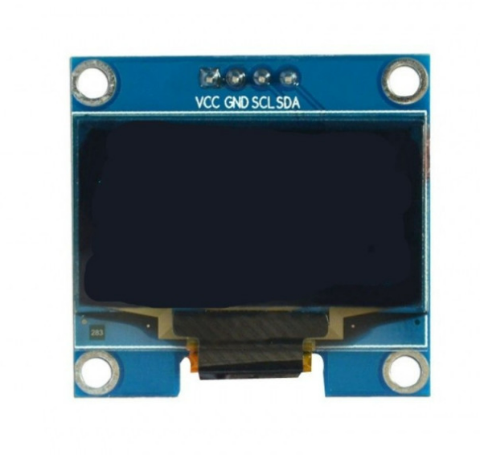
COMPONENTS
Arduino UNO
Gas sensor
DHT22
Components with appropriate budget=800 rupees
OLED display

Slide 15
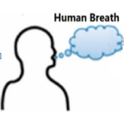
METHODOLOGY
GAS SENSOR MODULE
AURDINO UNO
OLED GRAPHIC DISPLAY
TEMPERATURE AND HUMIDITY SENSOR

Slide 16
To create a human breath analyzer to measure ketosis using an Arduino Uno, gas sensor, and temperature and humidity sensor, the following methodology can be used:
Gather the required materials: Arduino Uno board, gas sensor (such as MQ-135 Gas Sensor Module), temperature and humidity sensor (such as the DHT22 sensor), breadboard, jumper wires, and a power supply.
Connect the temperature and humidity sensor to the Arduino Uno board using jumper wires. to a power supply, such as a USB cable.
Write and upload the code to the Arduino Uno board using the Arduino IDE. The code should read the analog signal from the gas sensor and convert it to a digital value. The digital values can be displayed on an LCD display or sent to a computer via serial communication.
Calibrate the gas sensor by exposing it to a known concentration of ketones. This can be done by using a ketone breath analyzer device to determine the corresponding concentration in the breath. Note the corresponding digital value in the Arduino IDE.
Use the calibrated sensor to measure the ketone concentration in a person's breath. This can be done by having the person exhale into the sensor for a few seconds. The digital value from the sensor can be converted to a corresponding ketone concentration using a calibration curve.
Take into account the temperature and humidity readings from the DHT22 sensor to adjust the ketone concentration calculation, as these factors can affect the accuracy of the gas sensor.

Slide 17
RESULT
The result of this method would be a measurement of the ketone concentration in a person's breath, taking into account temperature and humidity.

Slide 18
CONCLUSION
Breathalyzers are a growing field of study because of their potential to have a significant positive impact on patients' quality of life and compliance with diabetes monitoring.
What makes our technology different is that it only accounts for acetone and doesn't react with other components in the breath.

Slide 19
TIMELINE
Week 1: Literature survey and research.
Week 2: Procurement of hardware components.
Week 3: Connection, design and simulation of entire device.
Week 4: Tweaking the device and finishing the report.

Slide 20
REFERENCES
B.Dontha, M. Faltas, P. -I. Gouma and A. Kiourti, "Electromagnetic-Based Deformation Monitoring for PANI-CA Breath Acetone Sensors," in IEEE Journal of Electromagnetics, RF and Microwaves in Medicine and Biology, vol. 6, no. 4, pp. 524-531, Dec. 2022.
Y. Obeidat "The Most Common Methods for Breath Acetone Concentration Detection: A Review," in IEEE Sensors Journal, vol. 21, no. 13, pp. 14540-14558, 1 July1, 2021.
L. Ma et al., "PrFeO3 hollow nanofibers as a highly efficient gas sensor for acetone detection", Sensors Actuators B: Chem., vol. 255, pp. 2546-2554, 2018.
G. W. Saraswati, Y. -H. Choo and Y. J. Kumar, "Developing diabetes ketoacidosis prediction using ANFIS model," 2017 International Conference on Robotics, Automation and Sciences (ICORAS), Melaka, Malaysia, 2017.
J. Moore, N. Chaudhary and T. Akinyemiju, "Metabolic syndrome prevalence by race/ethnicity and sex in the United States national health and nutrition examination survey 1988-2012", 2017.
J. Anderson, "Measuring breath acetone for monitoring fat loss: Review", Obesity, vol. 23, no. 12, pp. 2327-2334, 2015.
W. Miekisch, J. K. Schubert and G. F. E. Noeldge-Schomburg, "Diagnostic potential of breath analysis; focus on volatile organic compounds", Clin. Chim. Acta., vol. 347, pp. 25, 2004.

Slide 21
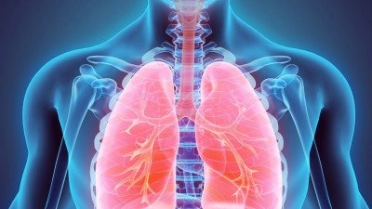
THANK YOU

